Slide 1
Recommending Products to clients
FINTECH 2025-2026 Business Case 2

Slide 2
Data Preprocessing
What can we realistically expect to get out of our dataset?

Slide 3
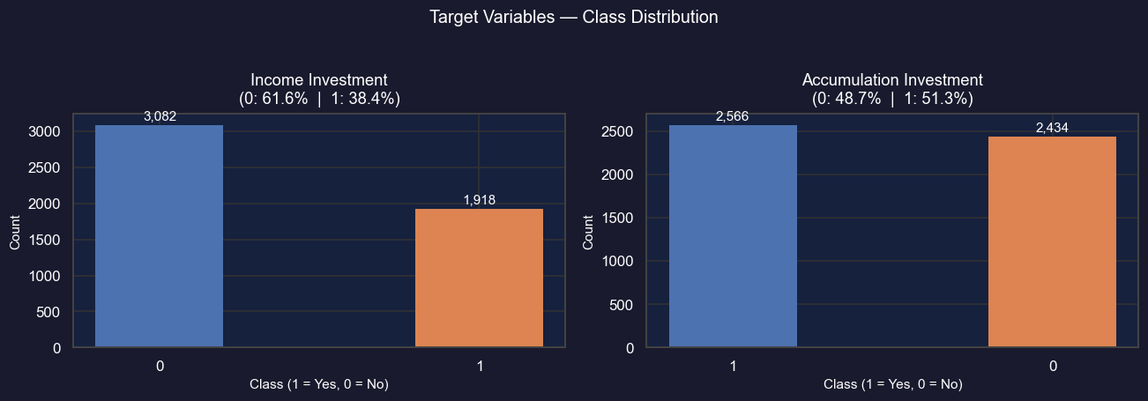
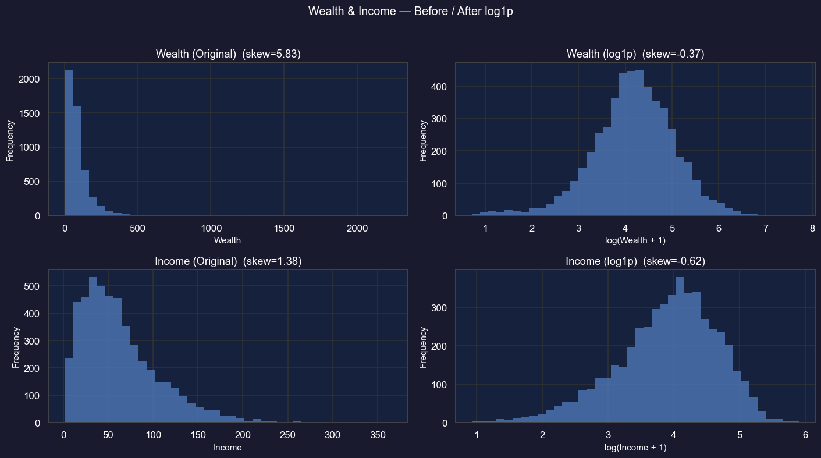
Data Exploration
Our process
Data Cleaning
Drop ID as it is uninformative
Shuffle rows
Separate features from targets
Check target classes balance
Skew reduction
Wealth and Income are highly skewed
We apply log1p for skew reduction

Slide 4
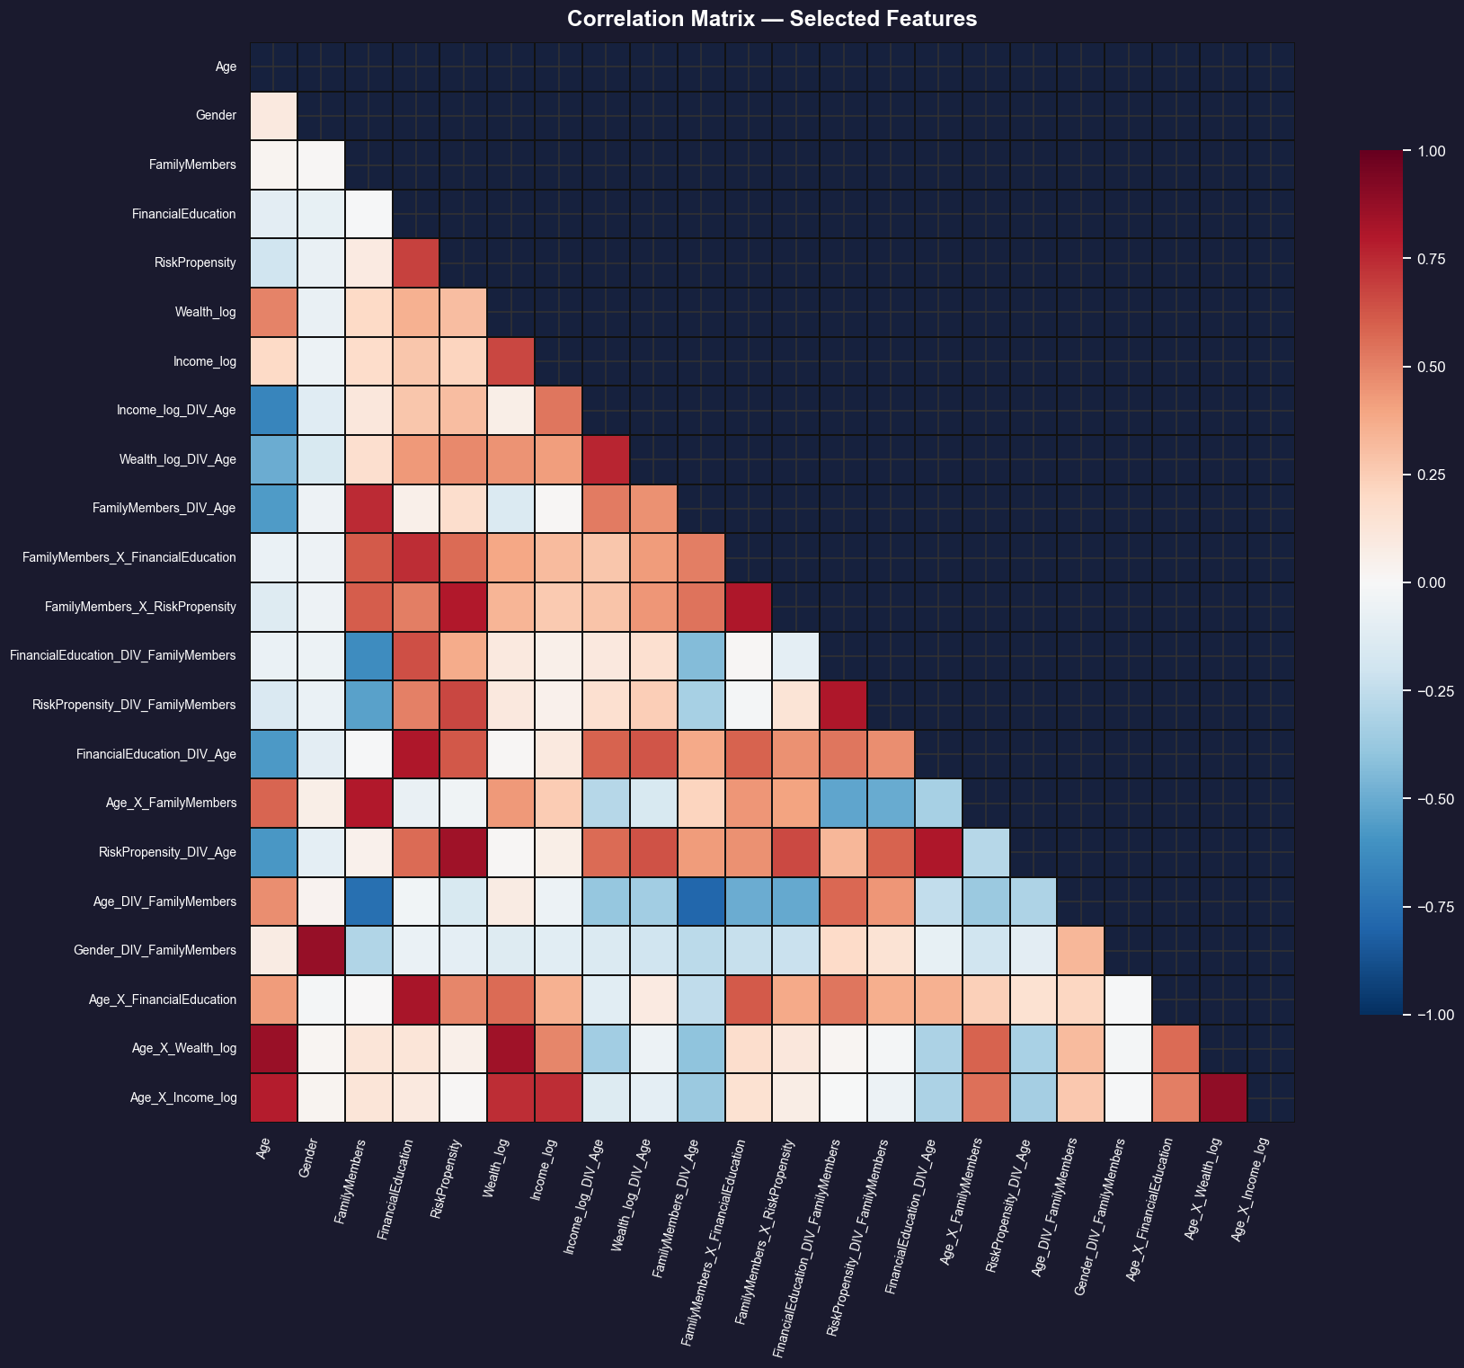
Feature Engineering and Exploratory Data Analysis (aka the result)
The Mathematical Approach
We aim to have low correlation with all variables
And high predictive power
We tried all the combination of 2-3 features with all the operations (+,-,x,/)
The Business Approach
Based on common sense we have:
IncomePerFamilyMember_log = log1p(Income / FamilyMembers)
Income_Wealth_Ratio_log = log1p(Income / Wealth)
SophisticationScore = FinancialEducation × RiskPropensity

Slide 5
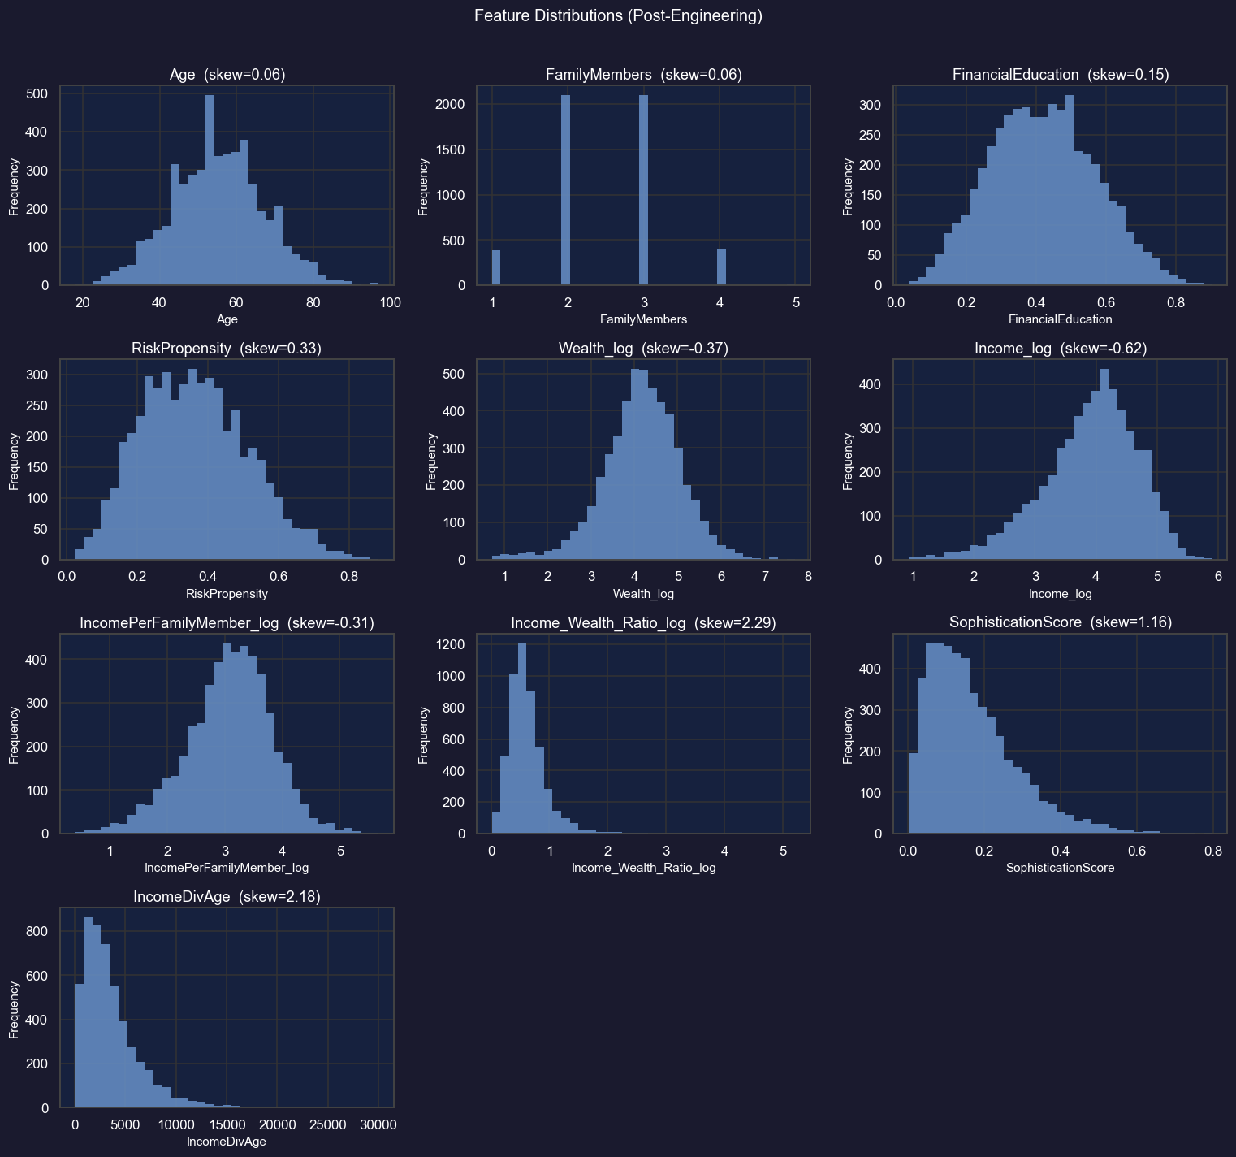
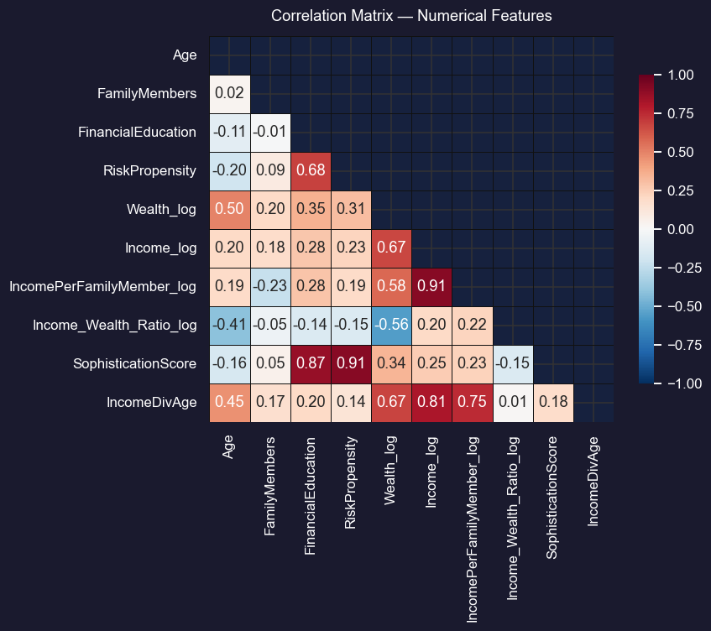
Exploratory Data Analysis: Feature distributions and pairwise correlations after engineering.

Slide 6
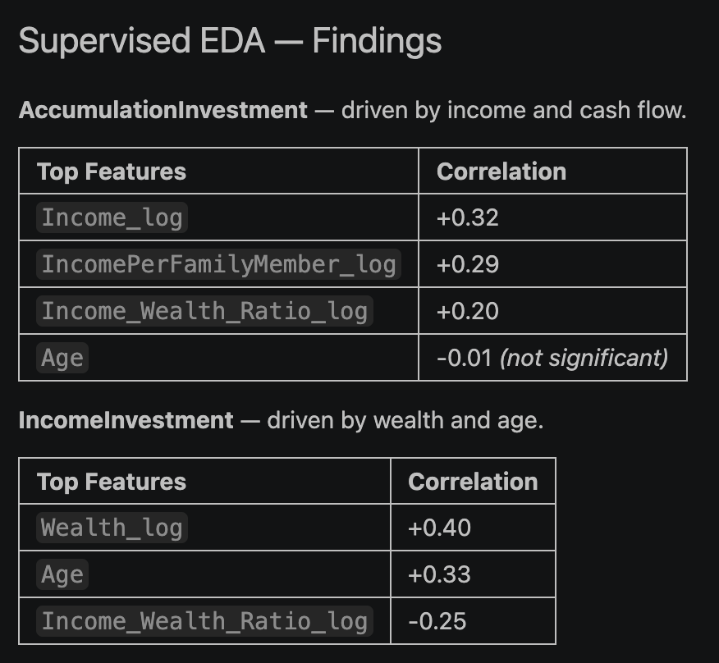
Supervised EDA
We are trying to understand how the features relate to the targets

Slide 7
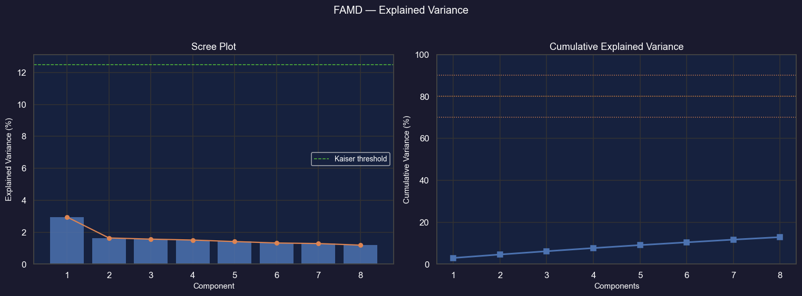
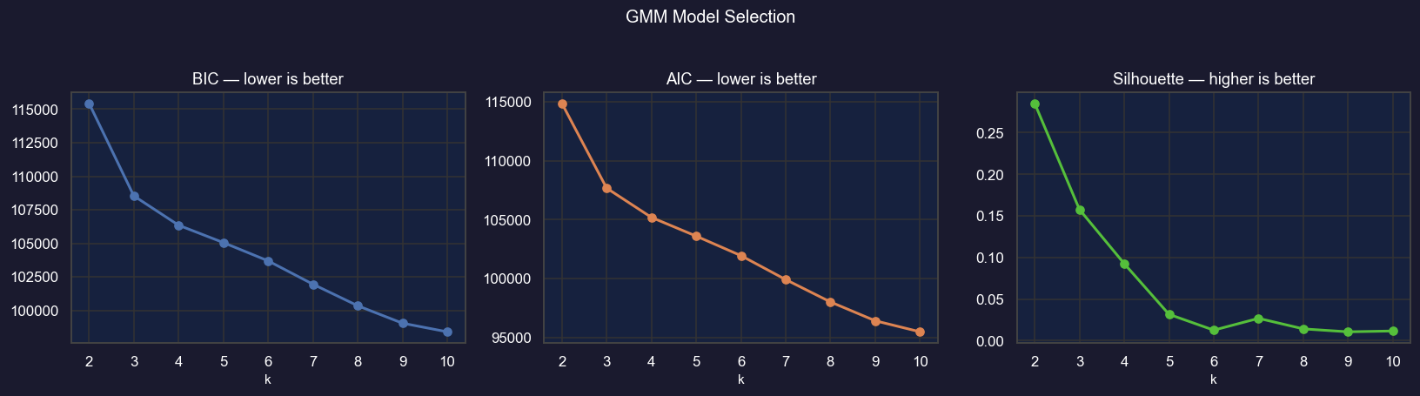
FAMD and GMM
Our findings from both methods aren’t significant.
This means that the variables are highly uncorrelated

Slide 8
The Reccomendation Engine
Classify users with respect to the accumulation or investment plans

Slide 9
Data setup
Apply a stratified 80/20 split of the data to prevent any leakage
Scale the training the data

Slide 10
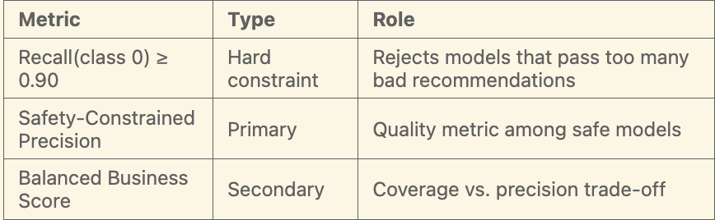

Model Evaluation Strategy (Metrics)
Accuracy
Precision
Recall: $\frac{TP}{TP+FN}$
Safety constraint: -1 if Recall(class0) < 0.9
F1 Score
$\text{Balanced} \text{Business} \text{Score}\text{ = }\text{α}\text{⋅}\text{Recall} \text{+} \text{(1−}\text{α}\text{)} \text{⋅} \text{Precision}$

Slide 11
Modelling
Logistic Regression
Linear baseline. Interpretable calibration reference for the ensemble.
XGBoost
Gradient-boosted trees. Strongest nonlinear learner; primary ensemble contributor.
K-Nearest Neighbors
Distance-based; captures local structure missed by global models. Sensitive to dimensionality.
Support Vector Machine
Margin-based classifier. Effective in medium-dimensional spaces; sensitive to scaling.
Gaussian Naive Bayes
Probabilistic baseline assuming feature independence. Fast and stable but limited on complex interactions.

Slide 12
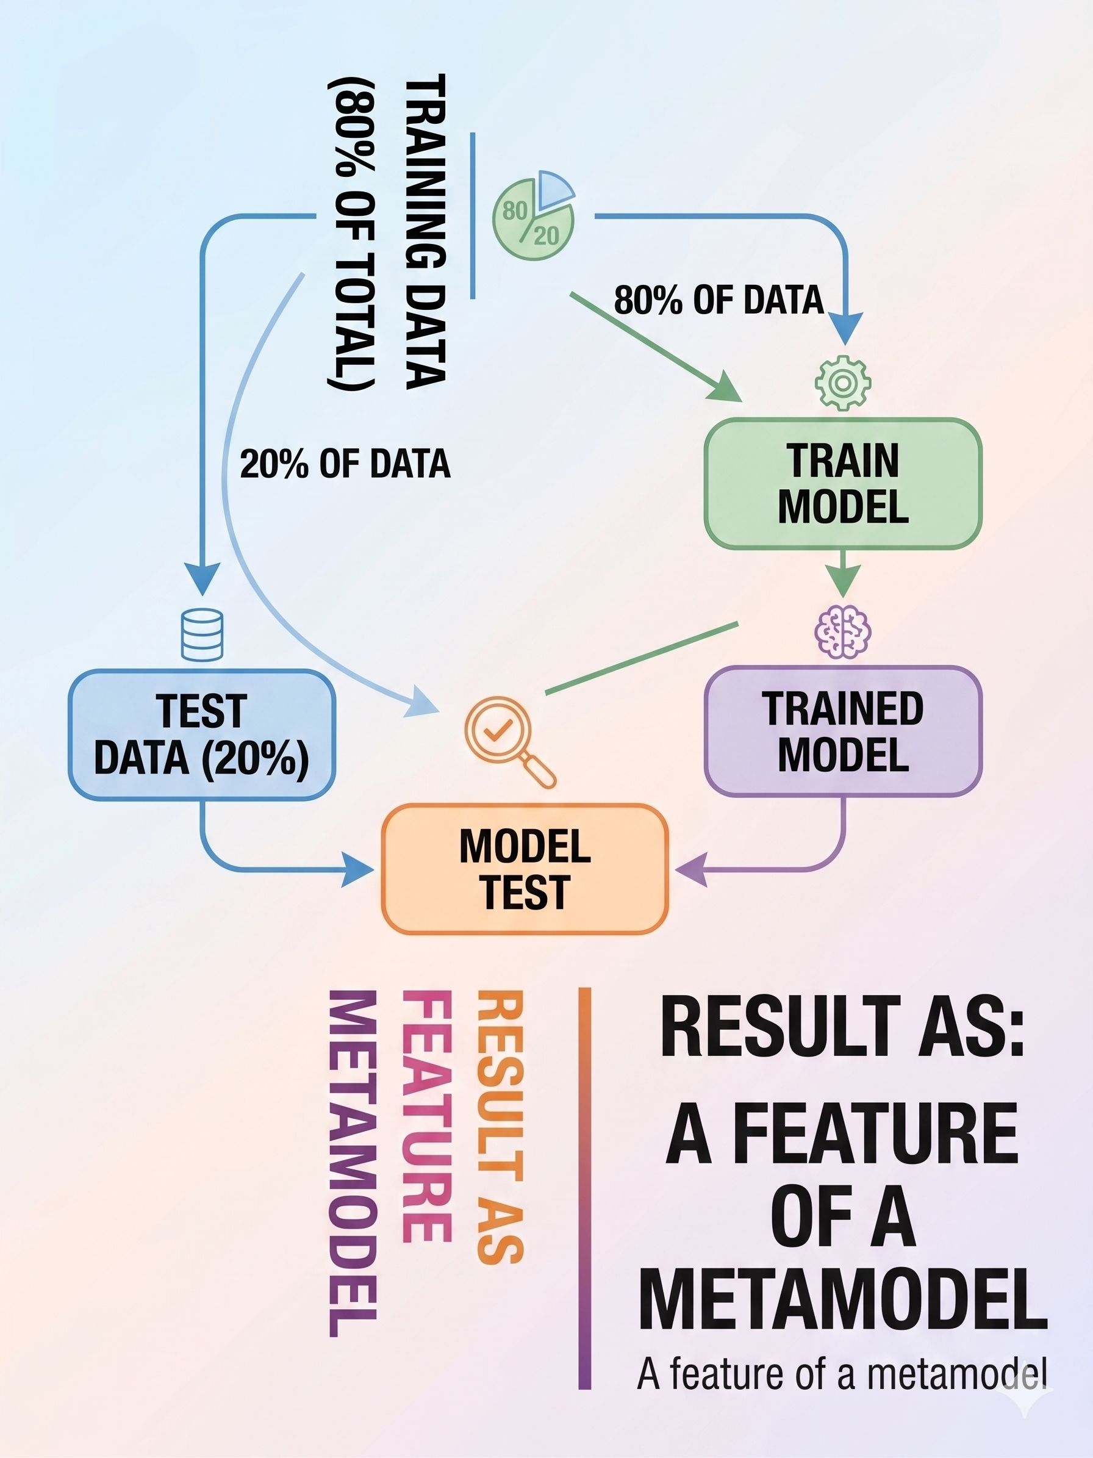
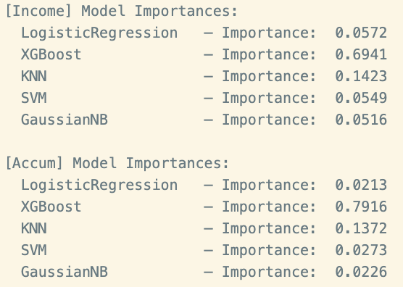
Modelling – Stacking Esemble
Metadata model assign importance (weights) to the 5 base model on the base of feature obtain from out of fold CV from every model
XGBoost Metamodel Model
We also try with Logistic Metamodel model but after we give 100% importance to XGBoost.

Slide 13
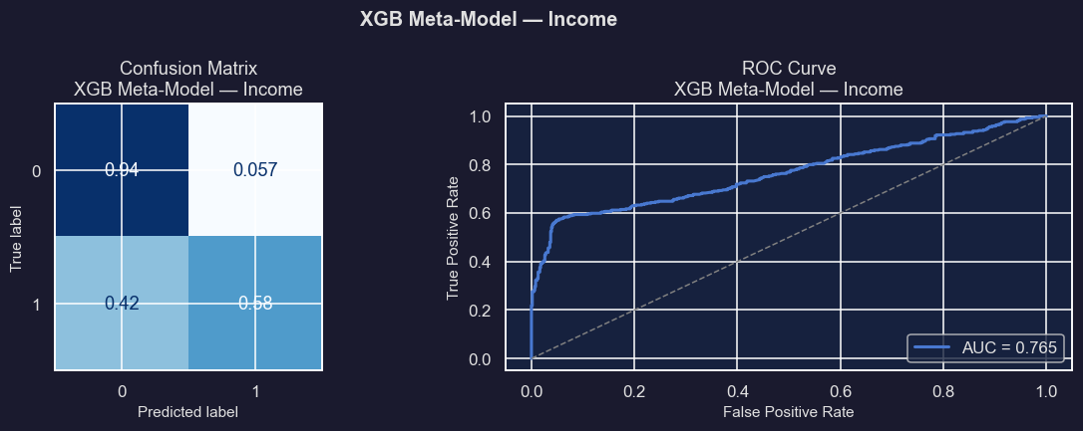
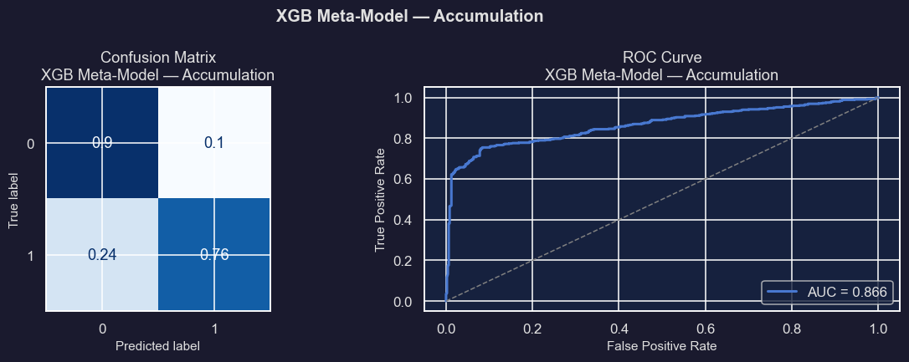
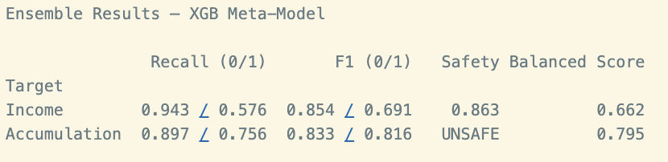
Metamodel Ensemble
Convert probabilities into decisions (treshold = 0.5) and analyzing performance with Confusion Matrix, ROC Curve and Metrics

Slide 14
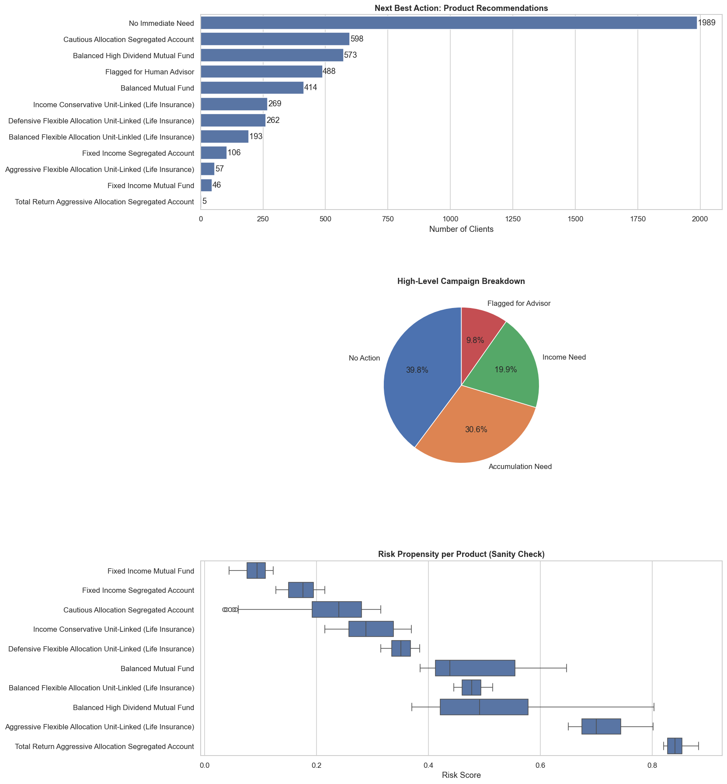
The recommendation system
Decision Logic: 1. Entropy Guardrail → 2. Threshold Check → 3. Conflict Resolution (highest probability wins).
Outcomes: INCOME | ACCUMULATION | NO_ACTION | ADVISOR_REVIEW
Income Threshold (0.35): Lowered from baseline to significantly boost Recall. Captures missed marketing leads and maximizes revenue with minimal drop in Precision.
Accumulation Threshold (0.40)
Entropy Guardrail (Top 5%): Regulatory safety net (MiFID/IDD). The 5% most uncertain predictions are excluded from automation and routed to ADVISOR_REVIEW to prevent inappropriate recommendations.

